Slide 1
git started
@ 16:45
gaelcolas

Slide 2

Many thanks to our sponsors:

Slide 3
Git – it’s not about version control
Collaboration tool
Distributed
Manage change events
Managing Timelines
Managing Multiverse
Should you prefer to go on your own, meet us there at 1845

Slide 4

Remember your first git lesson?

Slide 5
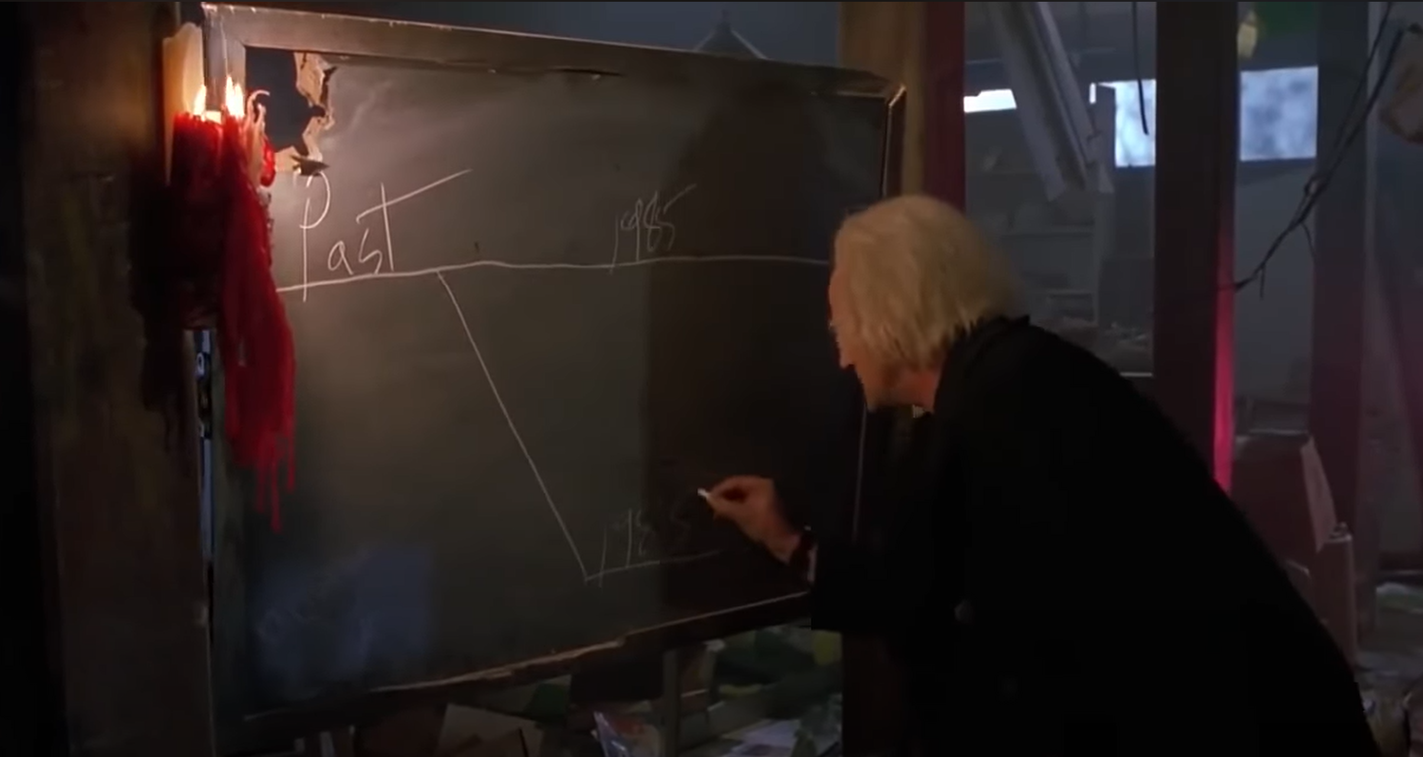
Timeline & Relative reality!
Notes:
“Alternate to you, me, but reality to everyone else”

Slide 6
Change event timeline
main

Slide 7
History is relative
main
git checkout –b gaelsRelativity
gaelsRelativity

Slide 8
History is relative
main
git add .; git commit –m ‘more stuff’
gaelsRelativity

Slide 9
History is relative
main
gaelsRelativity

Slide 10
History is relative
main
gaelsRelativity
Merge commits = BAD*
*Bad if you don’t know why / not intentional

Slide 11
git pull
main
gaelsRelativity

Slide 12
git pull
main
git pull
gaelsRelativity
Don’t pull Without Rebase*
git config --global pull.rebase true
Notes:
If you just pull

Slide 13
rebase
main
git pull --rebase
gaelsRelativity
Notes:
If you just pull

Slide 14
rebase
main
git pull --rebase
gaelsRelativity
Notes:
If you just pull

Slide 15
Enter the multiverse
Thank you Marvel for ‘splaining us…

Slide 16
Change event timeline
main
main
GitHub
Local

Slide 17
Change event timeline
main
GitHub
git clone git@github.com:myrepo.git
main
Local

Slide 18
Change event timeline
main
GitHub
main
Local
git checkout –b gaelsRelativity
gaelsRelativity

Slide 19
Change event timeline
main
GitHub
main
Local
git add .; git commit –m ‘more stuff’
gaelsRelativity

Slide 20
Change event timeline
main
GitHub
main
Local
gaelsRelativity
gaelsRelativity

Slide 21
Change event timeline
main
GitHub
gaelsRelativity
main
Local
git push –u origin gaelsRelativity
gaelsRelativity

Slide 22
Change event timeline
main
GitHub
gaelsRelativity
main
Local
git pull --rebase origin main
gaelsRelativity

Slide 23
Change event timeline
main
GitHub
gaelsRelativity
main
Local
git pull --rebase origin main
gaelsRelativity

Slide 24

Change event timeline
main
GitHub
gaelsRelativity
main
Local
git push
gaelsRelativity

Slide 25
Change event timeline
main
GitHub
Pull Request
gaelsRelativity
main
Local
git push --force
gaelsRelativity
gaelsRelativity

Slide 26
git push --force-with-lease
Jakub’s note (@nohwnd):
--force alone is destructive
If someone pushed commits to your branch, you’ll lose it (on the remote)
Better to use --force-with-lease
This won’t push if there’s missing commits on that remote

Slide 27
Q&A
15 minutes

